Slide 1
CODERS ONLY
We code even as we party.

Slide 2
details
When ?
Where ?
Time ?

Slide 3
Thought process
We love to code !
Code rules the party.

Slide 4
theme
Dress code
Party setup

Slide 5
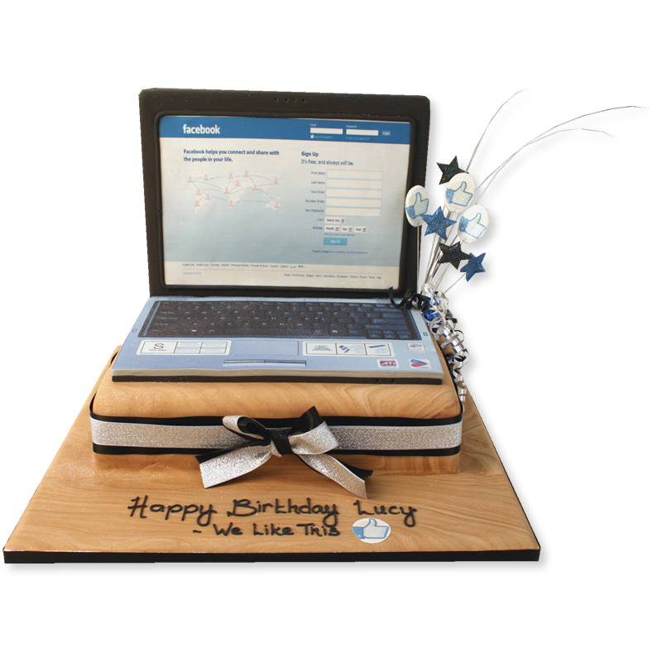
Drinks and refreshments
Food well cooked using AI (artificial intelligence)
Served by robots.

Slide 6
entertainment
Code based music
Coding drinking games
Design games

Slide 7
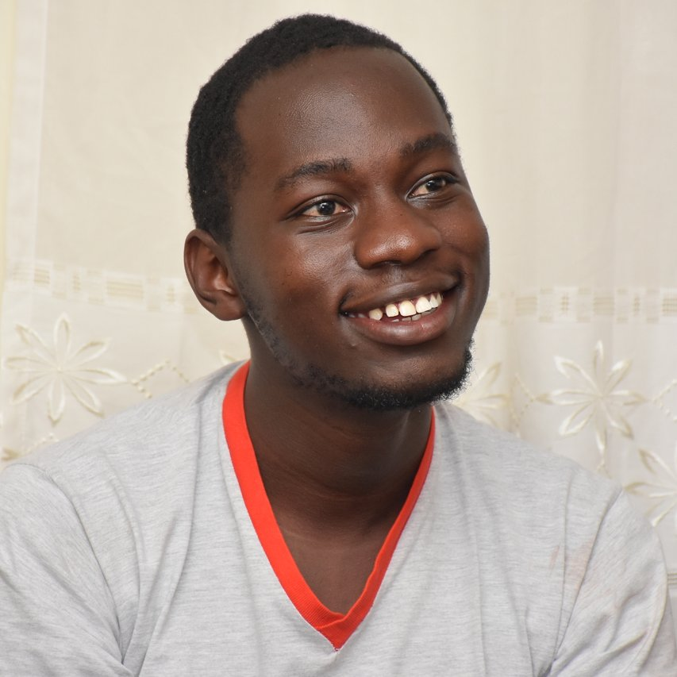
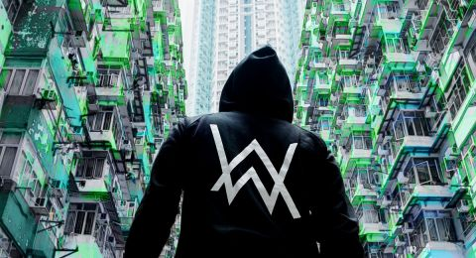
In attendance
Our fellow coders (Mark Zuckerberg, Bill Gates, Jeff Bezos, Pascal Aloo from Canada)
Electronic dj’s because we do electronics (Marshmello, Kygo, Calvin Harris, Alan Walker)

